Slide 1
Notes
BMLWS
M. Vladymyrov

Slide 2
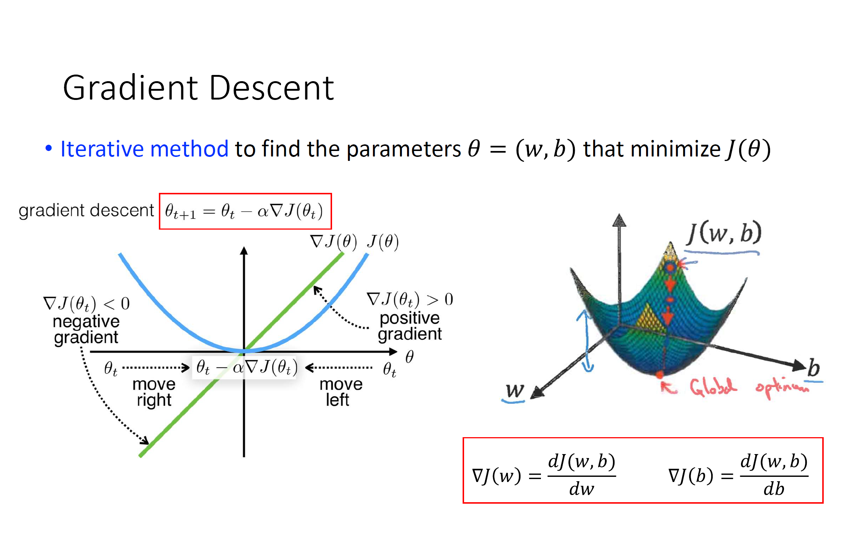
(adopted from lectures)

Slide 4
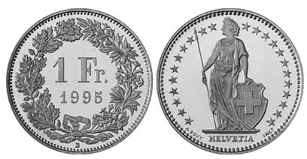
Classes encoding
X = 0
X = 1

Slide 5
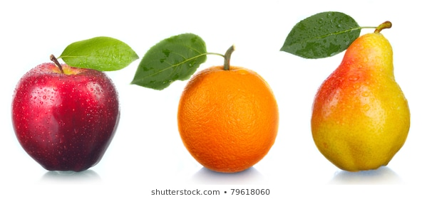
Classes encoding
X = 0
X = 1
X = 0
X = 1
X = 2

Slide 6
Classes encoding
X = 0
X = 1
X = 0
X = 1
X = 2
Can be though of as probability
Doesn’t make sense!!!

Slide 7
Classes encoding
We need some encoding such that each class has equal “status”.

Slide 8
Classes encoding: 1-hot
1
0
0
1
X =
X =

Slide 9
Classes encoding: 1-hot
1
0
0
0
1
0
0
0
1
1
0
0
1
X =
X =
X =
X =
X =

Slide 10
Classes encoding: 1-hot
1
0
0
0
1
0
0
0
1
1
0
0
1
X =
X =
X =
X =
X =

Slide 11
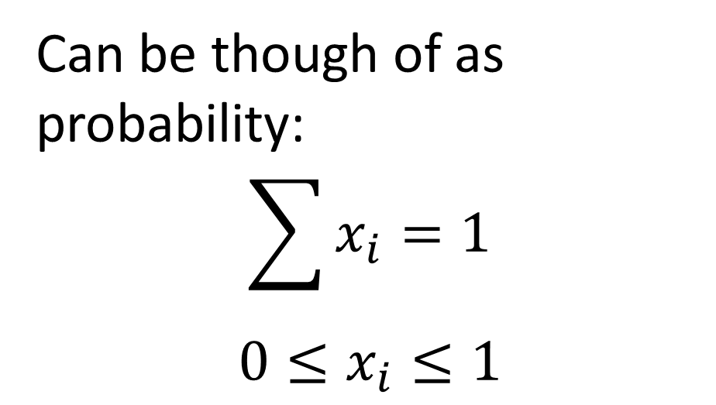
Classes encoding: 1-hot
Can be though of as probability:
$$\sum{x_{i}=1}$$
$$0≤x_{i}≤1$$
1
0
0
1
X =
X =

Slide 13
Convolutions
1
2
3
4
5

Slide 14
Convolutions
1
2
3
4
5

Slide 15
Convolutions
1
2
3
4
5

Slide 16
Convolutions
0.2
0.6
0.2
1
2
3
4
5

Slide 17
Convolutions
0.2
0.6
0.2
1
2
3
4
5
0.2
1.2
0.6

Slide 18
Convolutions
0.2
0.6
0.2
1
2
3
4
5
0.2
1.2
0.6
2.0

Slide 19
Convolutions
0.2
0.6
0.2
1
2
3
4
5
0.4
1.8
0.8
2.0
3.0

Slide 20
Convolutions
0.2
0.6
0.2
1
2
3
4
5
0.6
2.4
1.0
2.0
3.0
4.0

Slide 21
Convolutions: “VALID”
0.2
0.6
0.2
1
2
3
4
5
0.6
2.4
1.0
2.0
3.0
4.0

Slide 22
Convolutions with padding: “SAME” size
0.2
0.6
0.2
0
1
2
3
4
5
0
0.0
0.6
0.4
1.0
2.0
3.0
4.0
3.8

Slide 23
Strided convolutions: stride=2 , “SAME”
0.2
0.6
0.2
0.2
0.6
0.2
0.6
0.2
0.2
0
1
2
3
4
5
0
1.0
3.0
3.8
1.0
3.0
3.8

Slide 24
Strided convolutions: stride=2 , “Valid”
0.2
0.6
0.2
0.6
0.2
0.2
1
2
3
4
5
2.0
4.0
2.0
4.0

Slide 25
Dilated convolutions: dilation=2, “SAME”
0.2
0.6
0.2
0.2
0.0
0.6
0.0
0.2
0
0
1
2
3
4
5
0
0
0.0
0.0
0.6
0.0
0.6
1.2
2.0
3.0
2.8
3.6

Slide 26
Transposed convolutions: stride=2, “SAME”
1
2
3
4
5
0.2
0.6
0.2
0
1
0
2
0
3
1
0
4
0
5
0
0
0.0
0.6
0.4
0.6
0.6
1.2
1.0
1.8
1.4
2.4
1.8
3.0
1.0

Slide 27
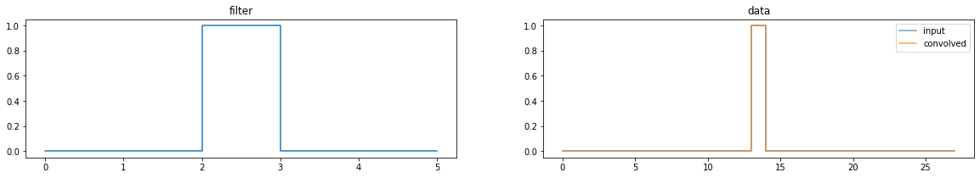
Effect of convolutions, 1D

Slide 28
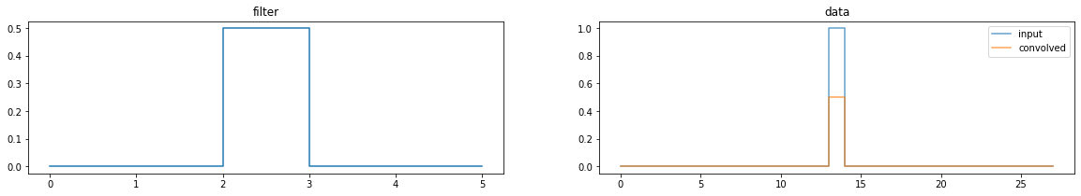
Effect of convolutions, 1D
Identity transformation
Scaling by
1/2

Slide 29
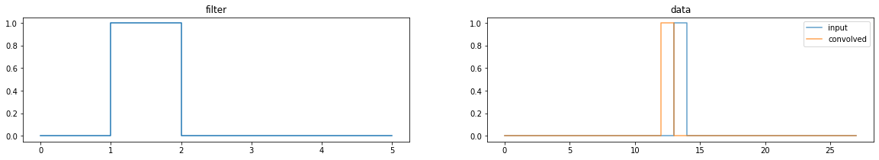
Identity transformation
1px left

Slide 30
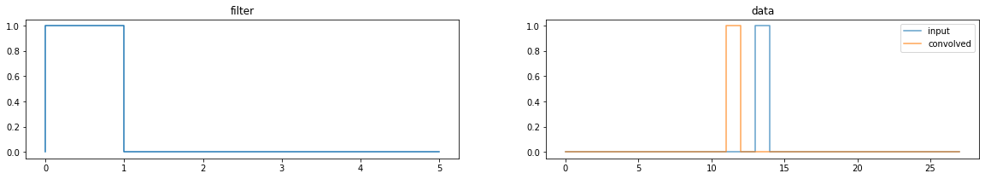
Identity transformation
1px left
2px left

Slide 31
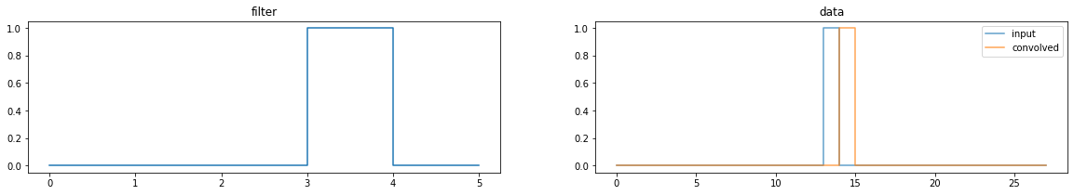
Identity transformation
1px left
2px left
1px right

Slide 33
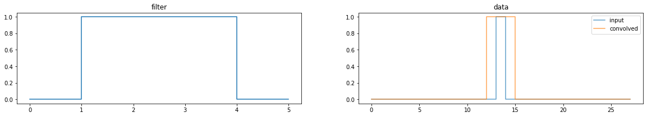
Convolution with a filter that is sum of other filters == sum of convolutions with each:

Slide 34
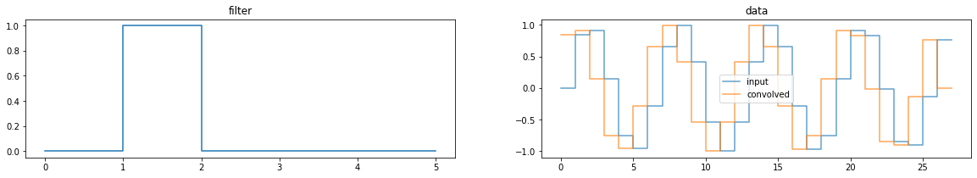
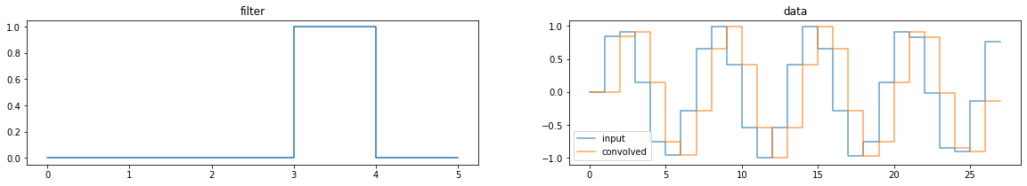
Effect of convolutions, 1D

Slide 35
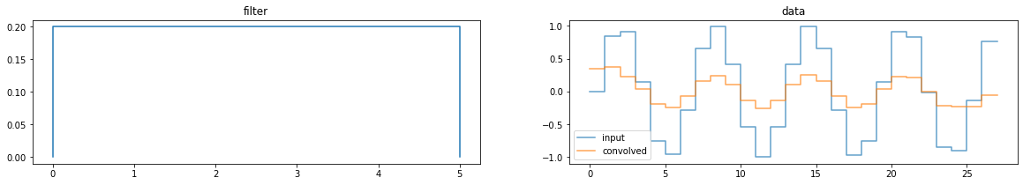
Effect of convolutions, 1D
Rectangular filter (sum of elements equal to 1) – blurring.

Slide 36
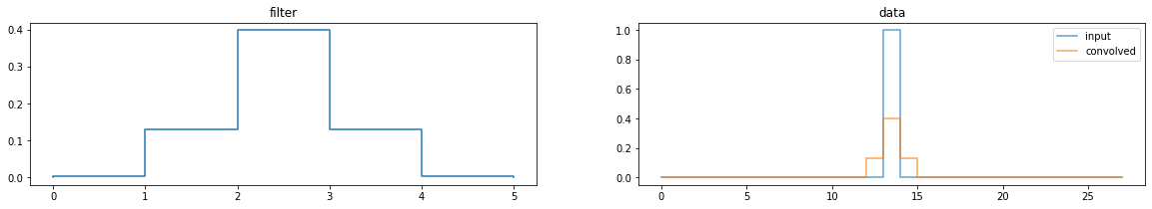
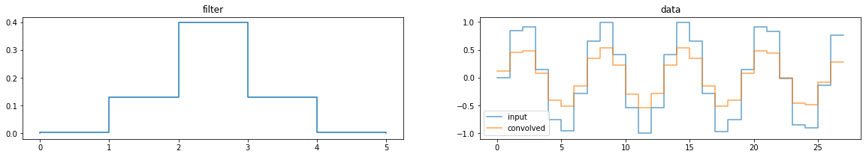
Gaussian blur
Gaussian filter

Slide 37
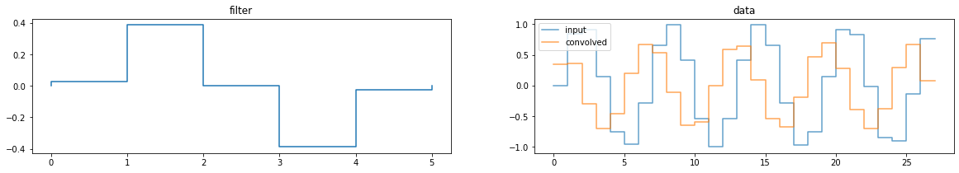
derivative/edge detector
Derivative of gaussian filter

Slide 38
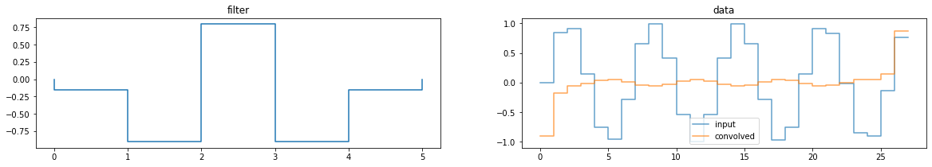
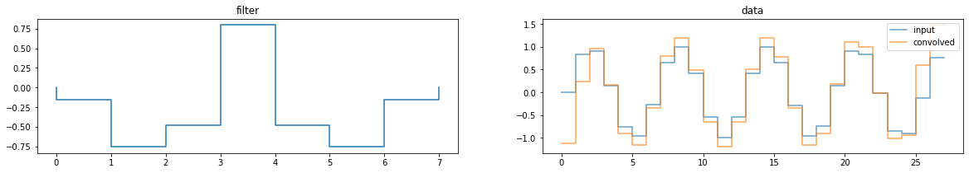
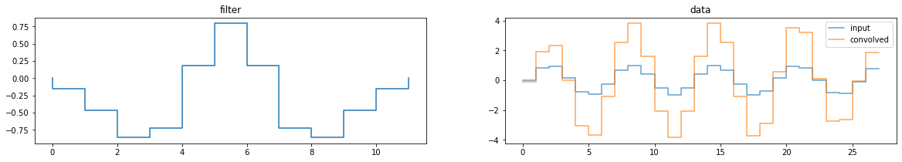
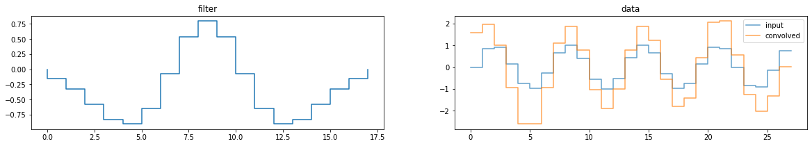
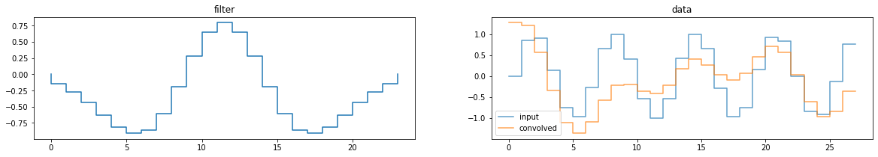
Peak detection
2nd derivative of
gaussian filter: notice how filter size affects the response

Slide 39
LSTM model
Embedding
LSTM
Dense
Data, size
LSTM state, size
x2 : 493
x3 : 493
x4 : 493
128
128
128
128
128
128
512
512
512
512
512
512
256
256
256
256
256
256
128
128
128
x1
x2
x3

